Slide 2
204: prspct.py
Python Programming for Prospect Researchers
John Connelly, Northwestern University

Slide 3

John Connelly
Associate Director, Northwestern University
BS, RIT – Rochester, NY
Working toward MS in Information Systems

Slide 4
Goal
My goal with this presentation is to give you an initial kick. To realize that it isn’t impossible or just for the nerds. That you, as a prospect research professional, can write programs that make your job easier and have fun doing it.
My goal isn’t to have everyone leave here a bona fide programmer. It is that you would leave here with the confidence to pick it up and learn something that you didn’t know the day before. It’s a commitment to a lifestyle that is never satisfied with what was learned or done the day before. Programming offers that opportunity.

Slide 5
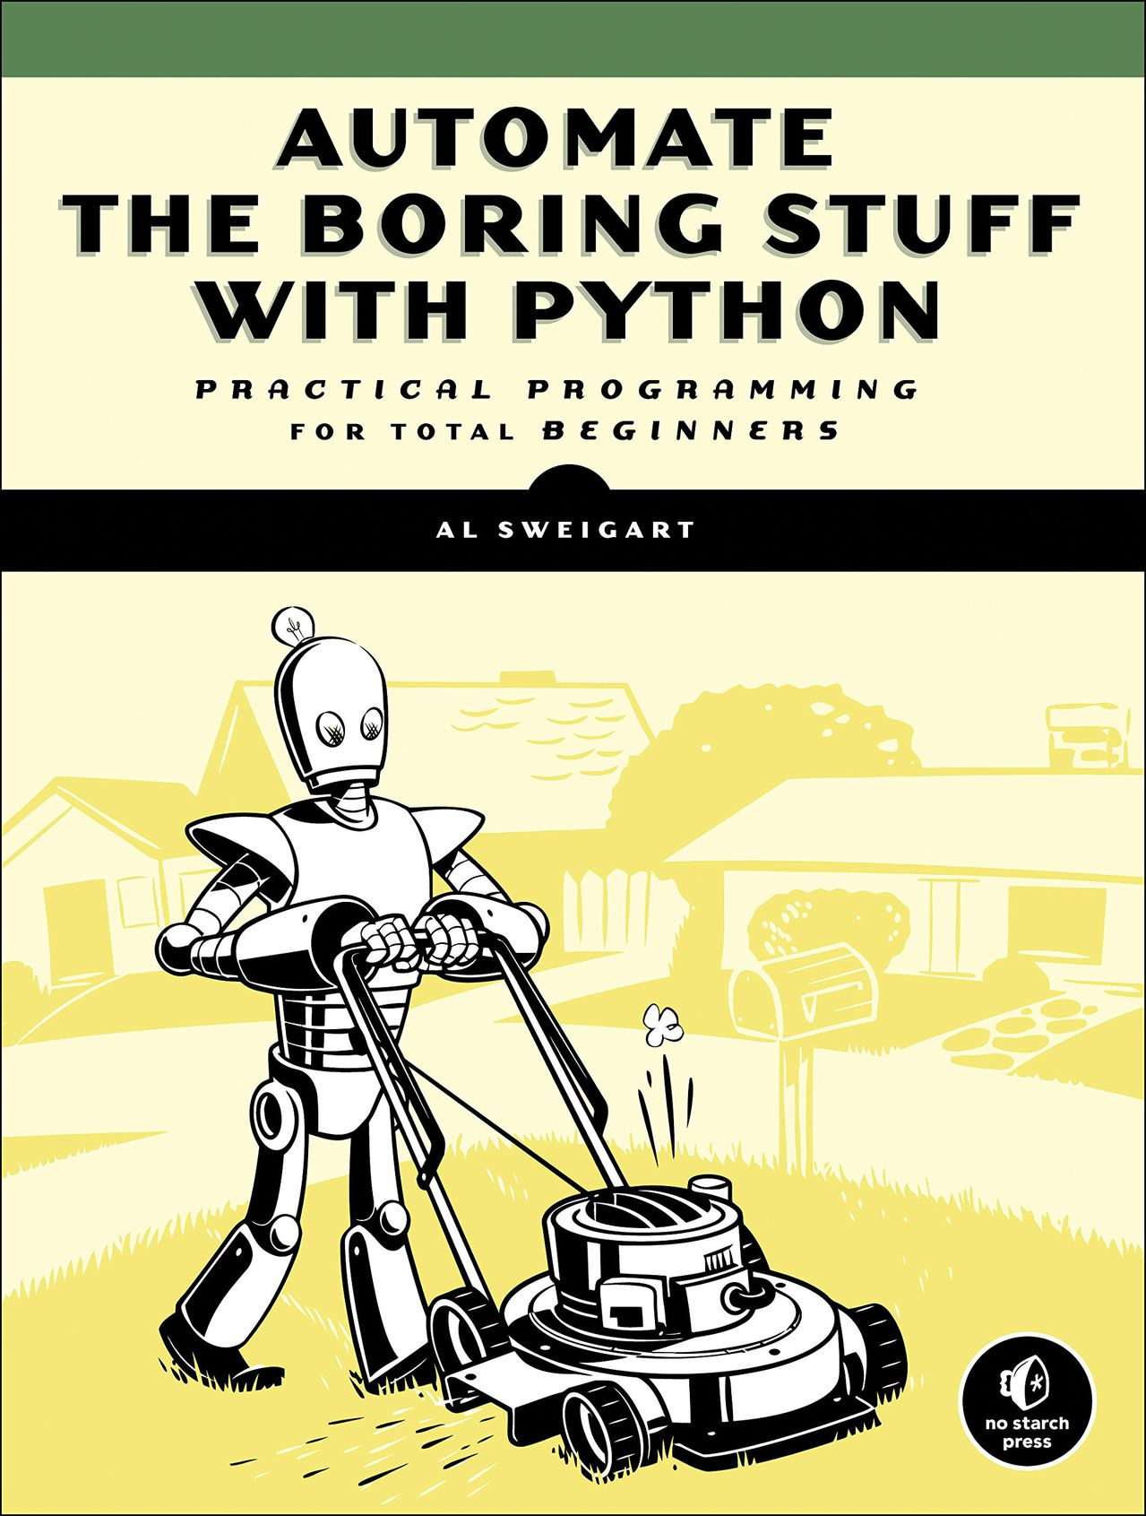
Inspiration
Automate the Boring Stuff with Python - Practical Programming for Total Beginners by Al Sweigart
https://automatetheboringstuff.com

Slide 6
Session Setup
If you have a laptop, please follow along!
Ask any question at any time
Don’t be afraid
Presenting from multiple venues
Powerpoint
Web
Jupyter Notebook
Desktop Apps
Python

Slide 7
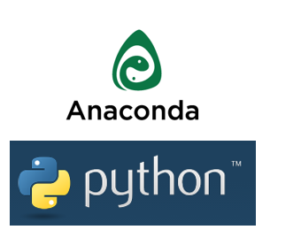
Installing Python
Anaconda
https://www.continuum.io/downloads
Anaconda is python, but allows you to download python with over 100 of the most popular packages.
You don’t need admin privileges (usually)!

Slide 8
Setup & Github
https://github.com/johnconnelly75/apra_2016
Find most of the files related to today’s talk
Notebooks will also be uploaded

Slide 9
Apology
Tons of material (overwhelming)
Take a deep breath
Revisit the goal
It’s okay if you don’t fully understand it right now
It’s not for everyone, and that’s okay

Slide 10
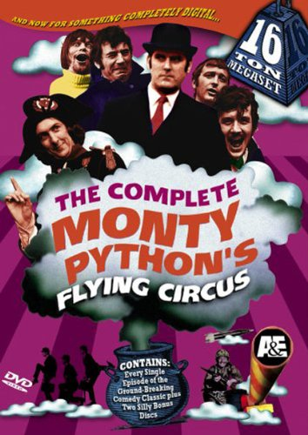
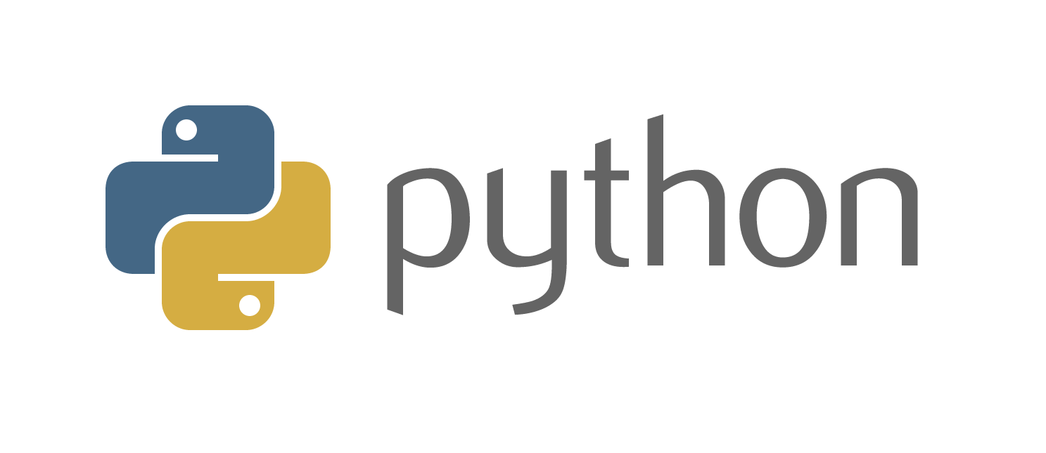
Programming via Python
What is python?
Why python?
Python 2 vs. Python 3

Slide 11

How to learn python
Practice
Read books
Watch YouTube videos
Coursera
Udacity
Udemy
Online Tutorials & Blogs
Documentation

Slide 12

Learning to ask questions
Knowing what question to ask is half the battle
StackOverflow
Google
Forums
Other people

Slide 13
Why python?
Incredibly efficient & clean
Great multi-purpose tool
Automate
Build simple or complex tools easily
It’s free!
Limited by your imagination
And maybe computer resources
Amazing community

Slide 14
Python vs. R
Python is a general-purpose language
For example, you can do data munging, data engineering, data wrangling, website scraping, web app building, and more.
R was specifically built for one purpose:
statistics & data analysis
Ultimately, it comes down to personal preference. They are both tools in your toolbox.

Slide 15
Why should you care?
Efficiency
Spend less time with processes that can be automated and more time on projects that matter
Research more effectively with less
It’s free (and relative low barrier of entry)
Bring context to your internal data!

Slide 16
Python and Prospect Identification
Research duct tape
Data source aggregation
Underlying infrastructure management
Ad hoc projects
Web scraping
Getting more out of your data
Text analysis
Ad hoc sensors
Monitoring news and other sources
Tracking events

Slide 17
Python and Prospect Identification
Examples
Project skeletons
Scraping Hospital and law office websites
Project and to do list Website!
Automate web searches through Google
Access vendor APIs (if they exist)
Parse event attendance and rich lists
Free data visualization
Mapping prospects
Analytics

Slide 18
Python and Prospect Identification
Even more examples
Collect and analyze team metrics
Automate capacity calculations
Efficiently manage research data and implement consistent analysis
Store and analyze all data related to real estate, compensation, stock, company comparables, foundation, collections, etc.
Automate profile generation
Track public companies
Track web pages and any changes

Slide 19
Libraries
Dependencies, Libraries, Modules, Packages, Oh my
(They’re basically the same thing)
I use Library
No re-inventing the wheel
Ability to import other projects

Slide 20
Libraries
Python Standard Library
Very Extensive
Native
https://docs.python.org/3/library/index.html#library-index
3rd Party Libraries
https://pypi.python.org/pypi

Slide 21
Documentation
Python standard library is very well documented
https://docs.python.org/3/tutorial/
Remember to document your own code
The better libraries are also well documented

Slide 22
Installing Libraries
Easy install
Pip install
Best to use
Conda install
Comes with Anaconda
Git
Version control
Setuptools
Making your own libraries!

Slide 23
Python Environments
Root
Conda
VirtualEnv
**This is something to look into**
Benefit: manage dependencies

Slide 24
PATH
You’ll need to research this further
Basically, the PATH environment variable is a list of folders, separated by semicolons, in which Windows (or whichever OS you use) will look for a program whenever you try to execute one by typing its name at a Command Prompt.

Slide 25
Running Python
File
Command Line (Terminal or PowerShell)
Python
iPython
Jupyter Notebook
We’ll be using Jupyter Notebooks primarily
IDE
Usually combines the above into a single program

Slide 26
IDE
IDE == Integrated Development Environment
I use PyCharm
Tons out there, so experiment
https://wiki.python.org/moin/IntegratedDevelopmentEnvironments
Good for things like code completion, inspection, and organization of files

Slide 27
Terminal Basics
Traversing filesystem via command line
cd
Making new folders (also called directories)
mkdir
Listing all files and folders in a directory
ls

Slide 28
Naming Files
.py
Only use standard characters for file names: letters, numbers, dash (-) and underscore (_).
White space (" ") should not be used at all (use underscores instead).
Do not use anything other than a letter (particularly no numbers!) at the beginning of a file name.
Do not use "non-English" characters (such as å, ɓ, ç, ð, é, õ, ü) in your file names—or, even better, do not use them at all when programming.

Slide 29
Python Basics
Datatypes
Boolean Operations & Comparators
Control
Loops
Variables
Functions
Classes
Object Oriented Programming
Exceptions
Tests

Slide 30
Variables & Scope
Global vs. Local
Local variables can be accessed only inside the function or code block in which they are declared
Global variables can be accessed throughout the program body by all functions
Globally scoped variables are, by convention (not requirement), UPPERCASE

Slide 31
Functions
Mini-program within a program
Blocks of code that can be reused
Parameters are passed in as input
Parameters can have a default value
Begins with keyword def followed by the name of function
You call a function
Methods are functions that belong to a class
Lambdas are anonymous functions (advanced)

Slide 32
Classes
Advanced python
Won’t cover much of this, but important to know
Classes define or prototype objects with a set of attributes and methods
When a class is set to a variable, an object is instantiated

Slide 33
Project Examples
Data Visualization
Mapping
Data access (Files I/O)
Databases
Excel
Notepad
Web
Ad hoc screenings
News Scraping
Building datasets (adding context to your DB)
Web scraping
Data management

Slide 34
Anatomy of a Web Scraper
Server (host computer)
Client (your computer)
Server-side code
ajax, javascript, php, python, etc.
HTML + CSS + Javascript
Browser
Python Program

Slide 35
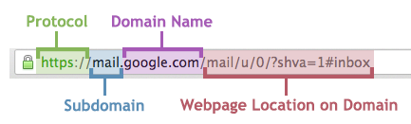
Getting Data from the Web
Crawling vs. Scraping
API
Restful
SOAP
JSON and XML
Screen Scraping
HTML
Javascript
JSON

Slide 36
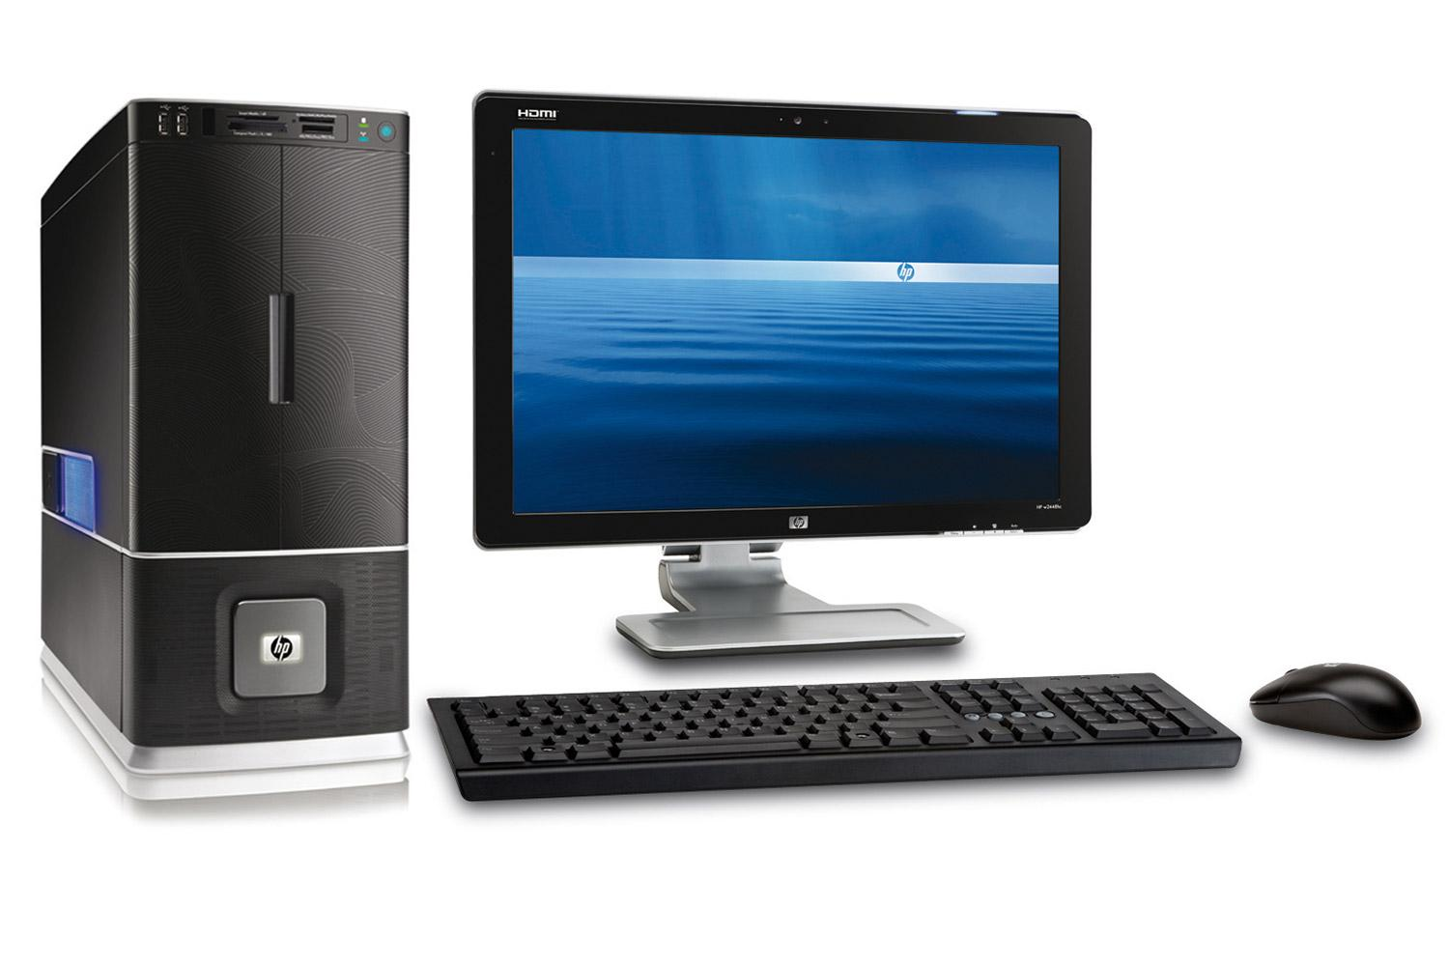
Anatomy of a Web Scraper
Request
API
{JSON} \ <XML>
Response

Slide 37
Anatomy of a Web Scraper
Request
Screen/Web Scraping
HTML / CSS / Javascript
Response

Slide 38
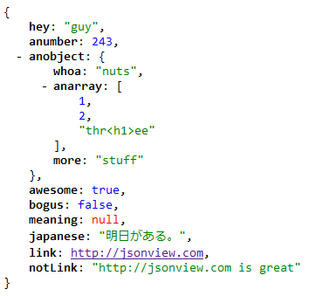
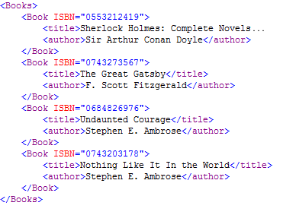
Getting Data from the Web
Crawling vs. Scraping
API
Restful
SOAP
JSON and XML
Screen Scraping
HTML
Javascript
JSON
JSON
XML

Slide 39
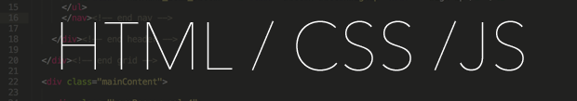
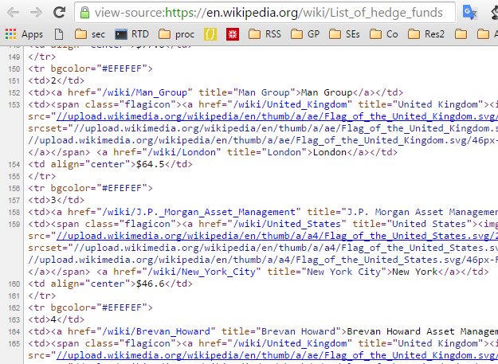
https://en.wikipedia.org/wiki/List_of_hedge_funds
HTML Basics
Tags
Tree-like structure
Open tag
<div>
Close tag
</div>
Tree traversal
xpath
CSS Selector

Slide 40
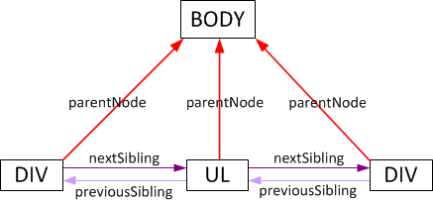
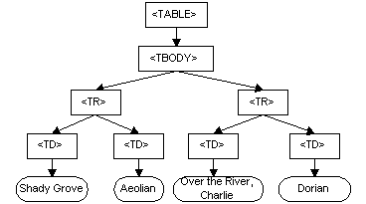
HTML Basics
Tags
Tree-like structure
Open tag
<div>
Close tag
</div>
Tree traversal
xpath
CSS Selectors

Slide 41
Relevant Libraries
Requests
Retrieves (and sends) data
Example code:
r = requests.get(url)
LXML
HTML Parser
Example code:
from lxml import html
b = html.fromstring(r.content)
Selenium
Controls browser
Example code:
from selenium import webdriver
fx = webdriver.Firefox()
fx.get(url)
BeautifulSoup
HTML Parser
Urllib3
Native library
Retrieves (and sends) data
Scrapy
Web Scraping Framework
Urlparse
Helps parse URLs
Feedparser
RSS Feed Parser
Newspaper
Article Extraction
Pattern
A bit of it all

Slide 42
Q&A
Email → john-connelly@northwestern.edu
Github → https://github.com/johnconnelly75
What are projects you’d like to tinker on with python when you get back?

Slide 43
Q&A
Email → john-connelly@northwestern.edu
Github → https://github.com/johnconnelly75
Favorite resources →
Automate the Boring Stuff & Other Books
Google & StackOverflow
Python Documentation
YouTube
Sentdex Channel
PyCon videos

Slide 44
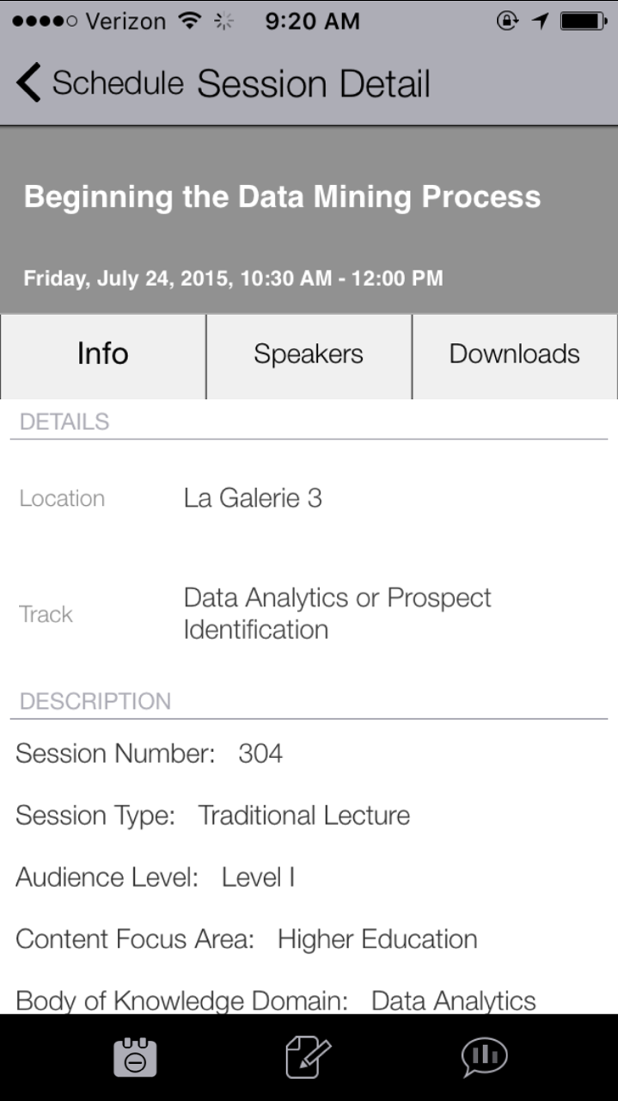
Thank you for attending. Please remember to complete the online evaluation of this session in the mobile app by selecting the bar graph icon.

